Slide 1
F & D PROJECT ST - 2
BY:
Aditya Moudgil
(2010990032)
Group : g5
Instructor: Mr. lavish Arora

Slide 2
About the project
Tried making the clone of Sony India Website under the given theme of Online Electronics Item Store.

Slide 3
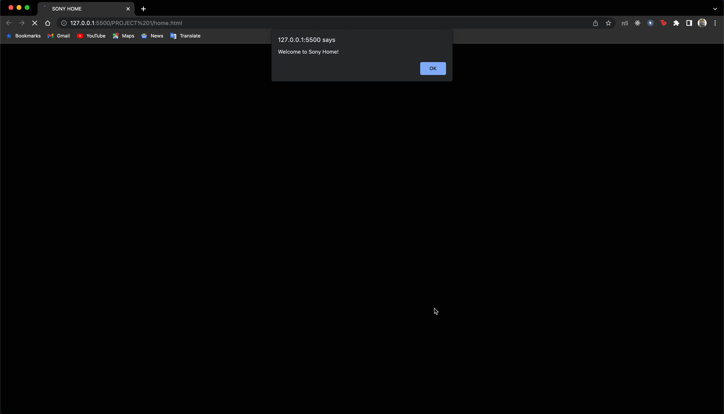
Home page

Slide 4
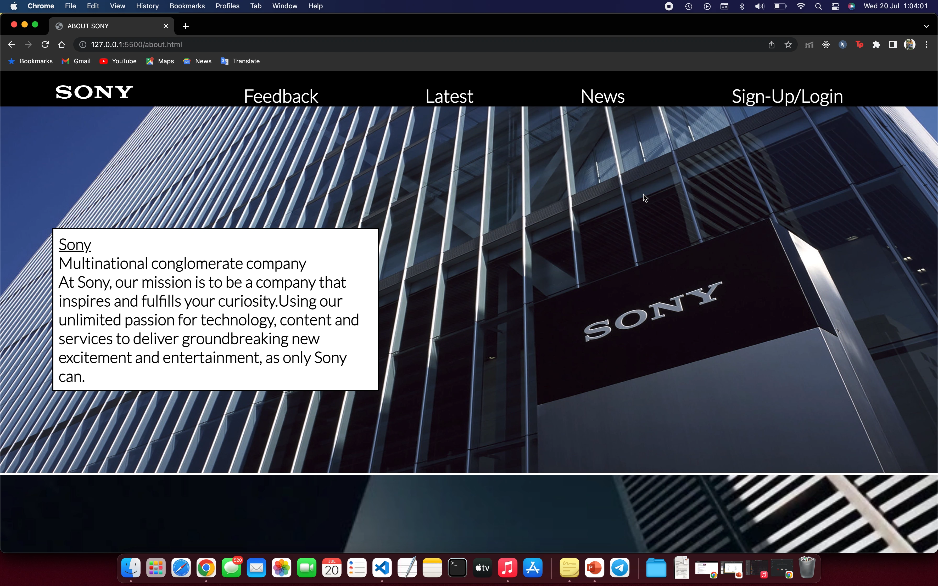
About us

Slide 5
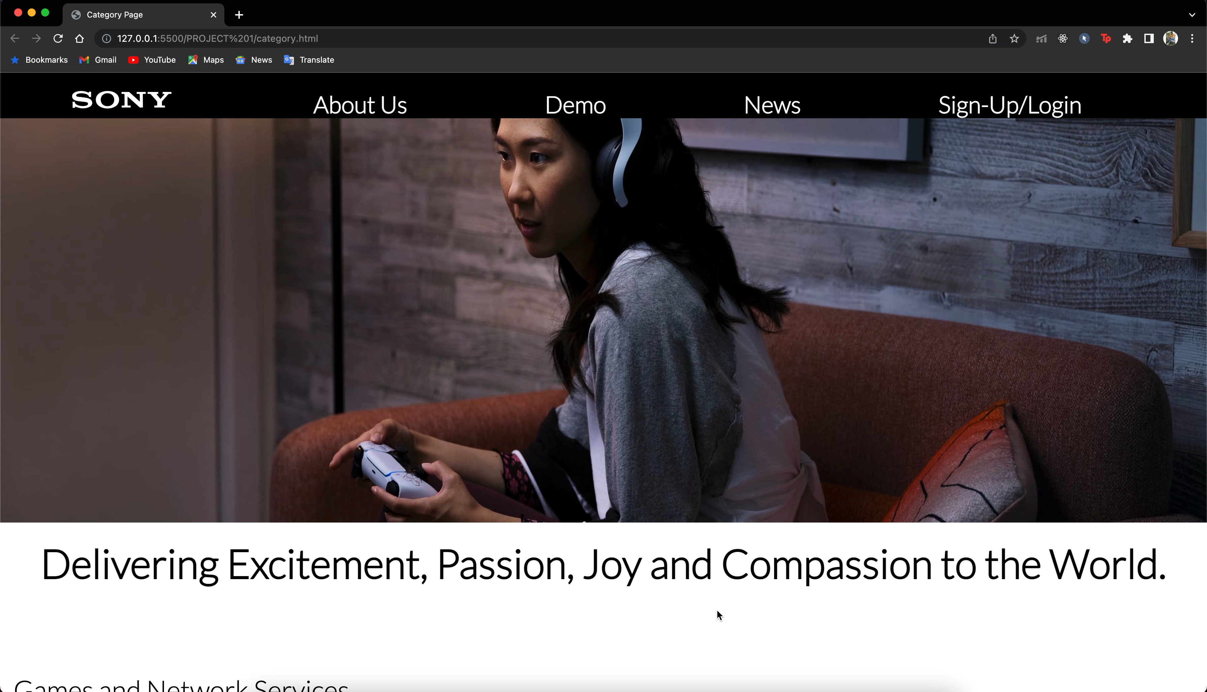
Category page

Slide 6
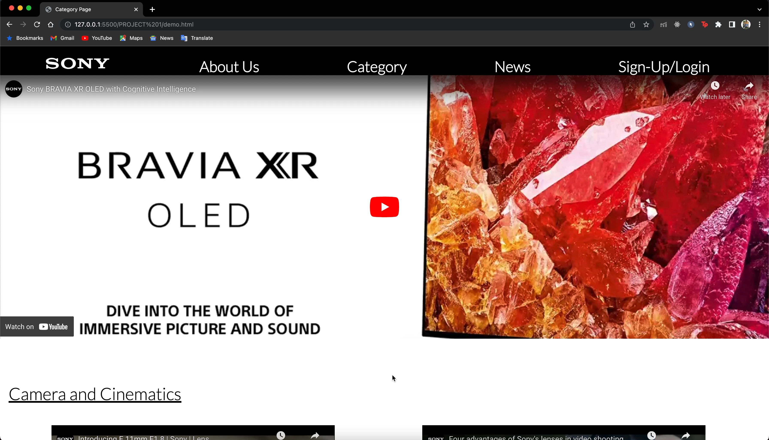
Demo page

Slide 7
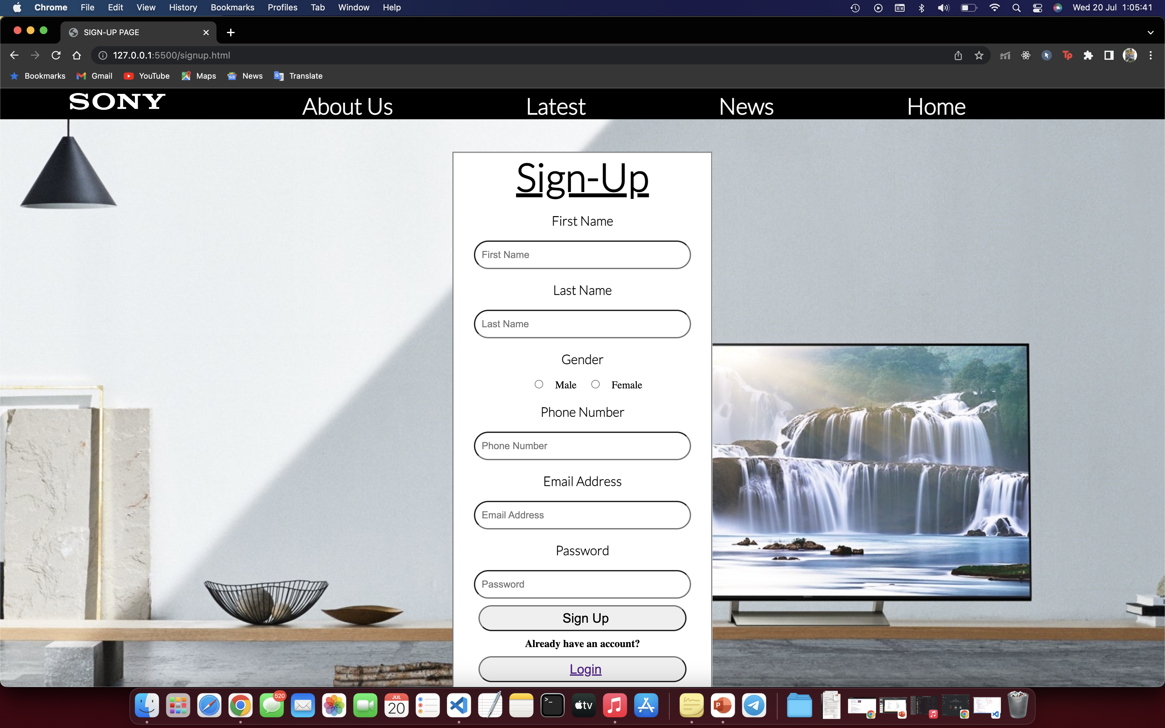
Sign-up page

Slide 8
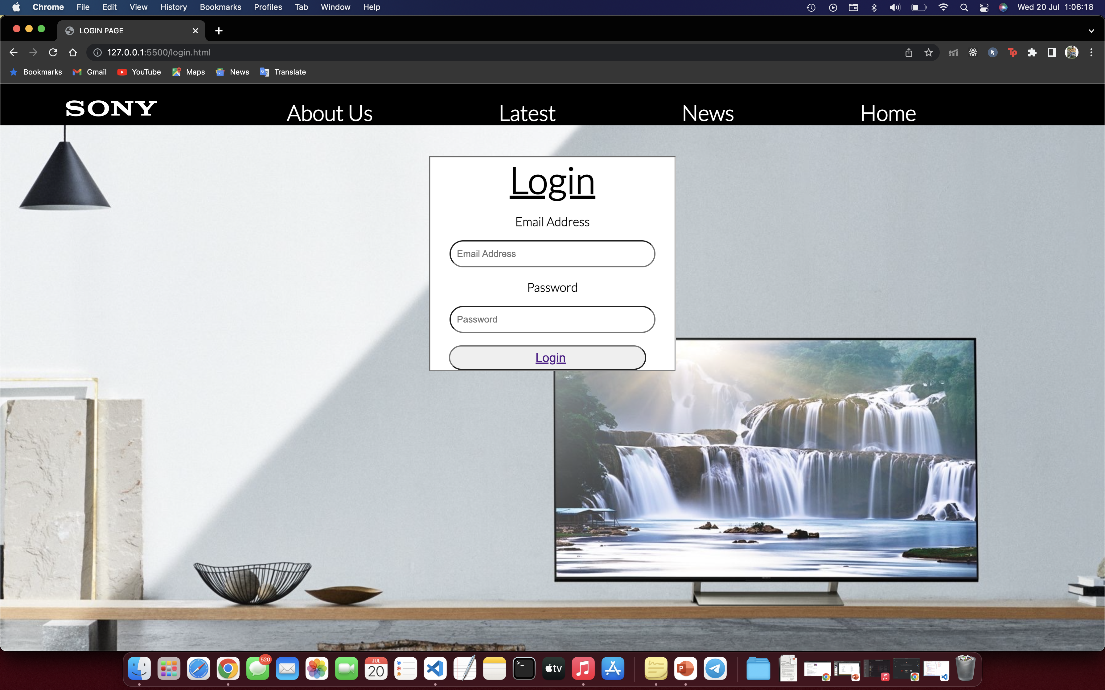
Login page

Slide 9
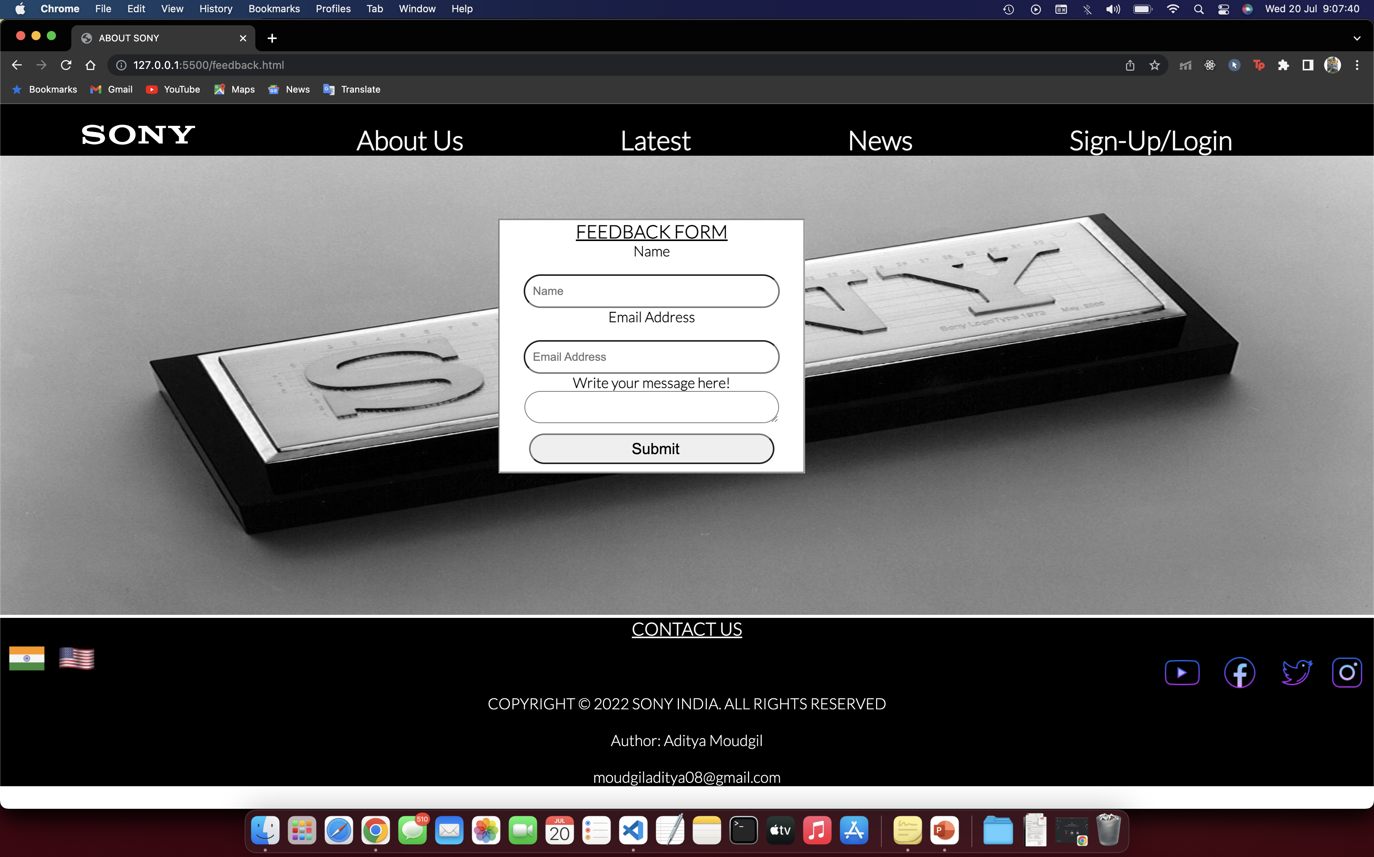
Feedback page

Slide 10
In this anticipated project, there are 7 pages till now.
Home
About Us
Category Page
Demo Page
Login
Sign Up
Feedback
The home page consists of sale, latest devices an news about SONY.
The about us page consists a brief information about SONY.
Category page has information about various businesses and initiatives by Sony Corporation.
Demo Page has many youtube videos regarding the products and services SONY offers.
All pages are interlinked with each other using <a> tag.

Slide 11
Html tags used
<div>
<p>
<b>
<ins>
<h1>,<h2>,<h3>,……
<img src>
<form>
<fieldset>
<iframe>
<input>
<button>
<a>
<br>
<text area>
<footer>

Slide 12
Css properties used
Position
(absolute, relative)
Margin
Display - Inline
Padding
Text – decoration
Height
Width
Border
Border radius
Border Color
Background color
Background image
Font – style
Font – family
Font – size
Hover
and a few others..!

Slide 13
Javascript properties used
window.alert
document.getElementbyID
if and else
time function
date function
arithmetic operators to create a discount calculator.

Slide 14
Thank you!

